Slide 1
Demo of ETL migration from DSpace to VIVO
Dspace-Vivo Integration Project
Michel Héon PhD heon.michel@uqam.ca University Of Quebec at Montreal
Michel Héon PhD - heon.michel@uqam.ca - University of Quebec at Montreal
Notes:
Data mapping between de VIVO and DSpace is a process that can be performed in multiple ways. Here we present three approaches that can be considered for this task
1

Slide 2
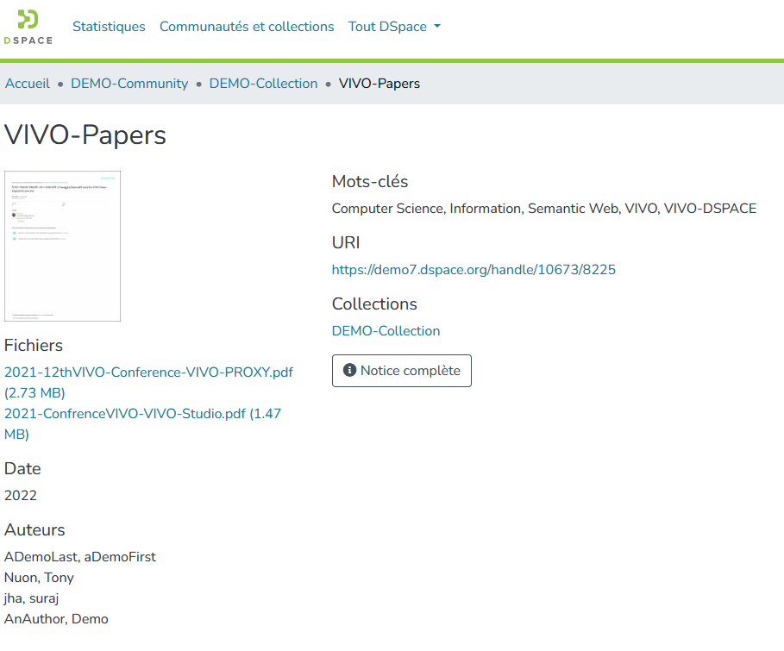
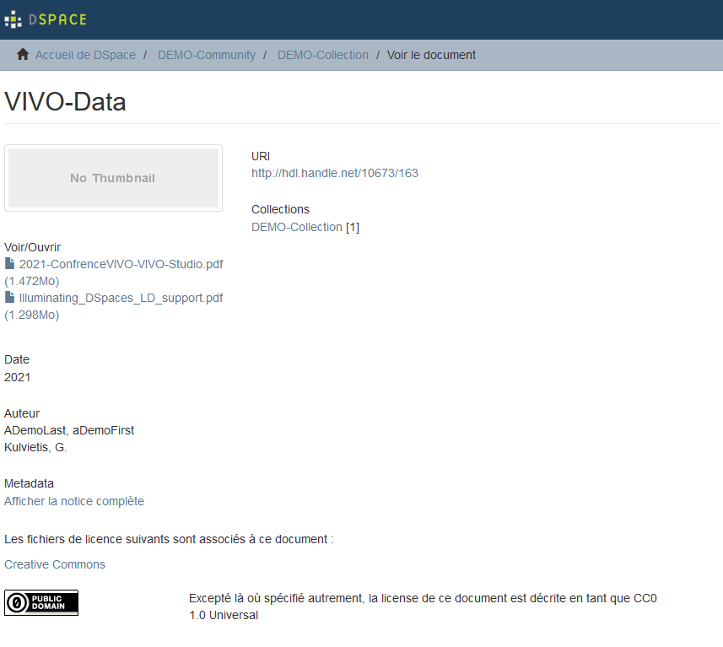
The scenario (VIVO in read mode) Migrating data from Dspace(6&7) into VIVO
https://demo7.dspace.org/items/cf13b35c-e5c0-4c8a-bbe8-3c60bd93de1c
https://demo.dspace.org/xmlui/handle/10673/163
Michel Héon PhD - heon.michel@uqam.ca - University of Quebec at Montreal

Slide 3
Data migration according to ETL Metamodel
Using the DSpace-Vivo Exchange Data Schema (DVExDS)
Source DataBase
Source Data
Target Data
Target DataBase
1)
2)
3)
Extract
Transform
Load
Michel Héon PhD - heon.michel@uqam.ca - University of Quebec at Montreal

Slide 4
DSpace 101 Data-Structure
Repository
Community
Collection
Item
BitStream
FreeStyle ID (No formal ID [url, uri, uuid, email, etc.]), just the name in String
Author
Subject
Michel Héon PhD - heon.michel@uqam.ca - University of Quebec at Montreal

Slide 5
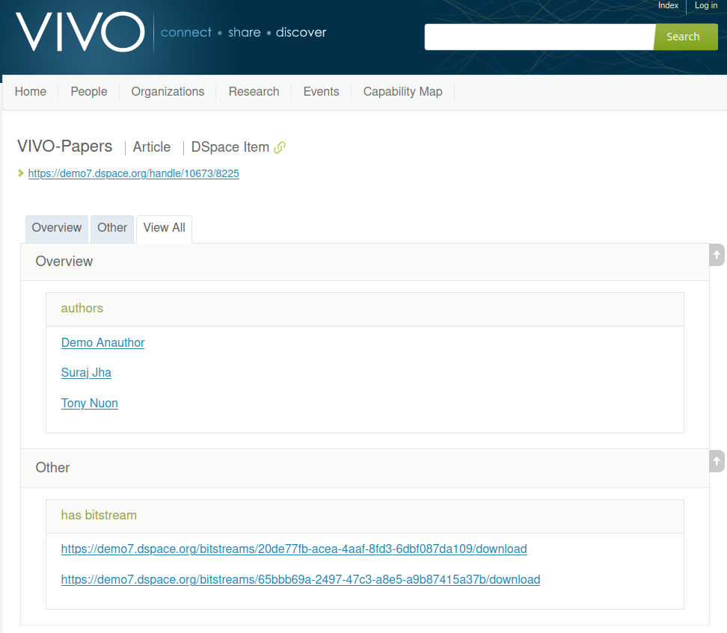
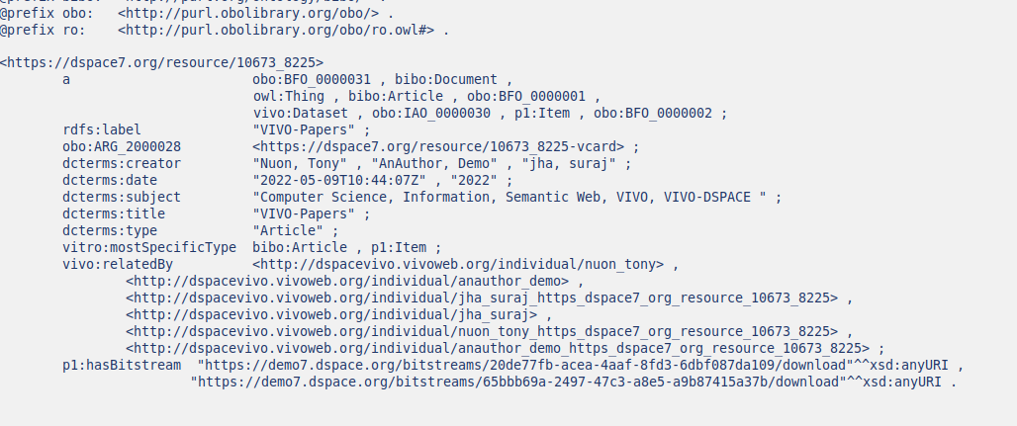
DSpace Item (1/2)
The original dspace metadata is preserved
DSpace creators are translated into foaf:Person in VIVO
Michel Héon PhD - heon.michel@uqam.ca - University of Quebec at Montreal

Slide 6
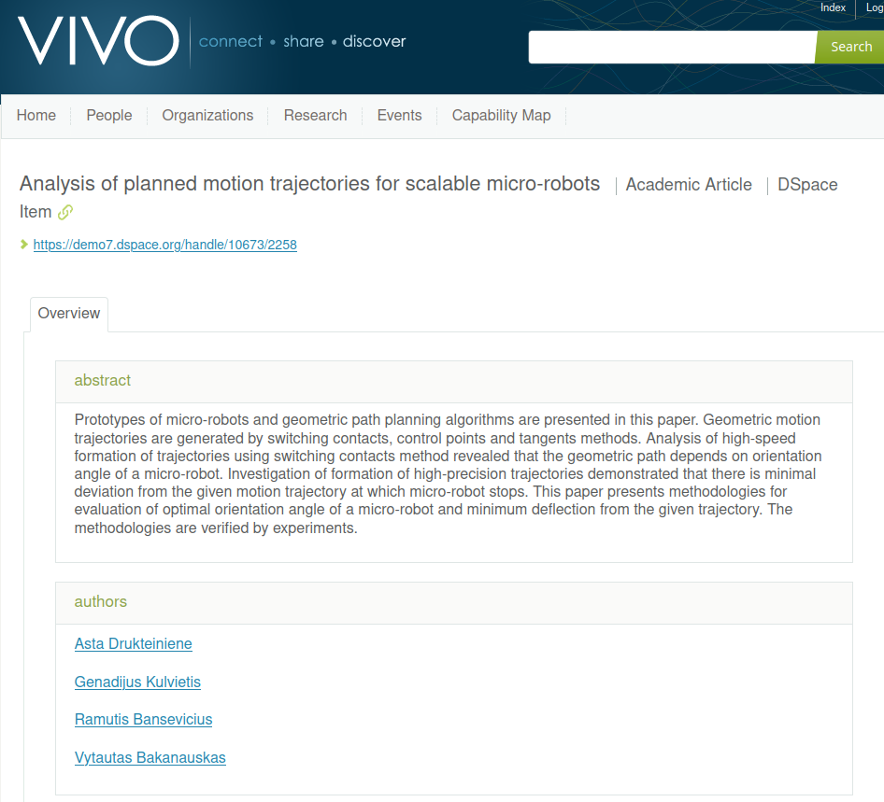
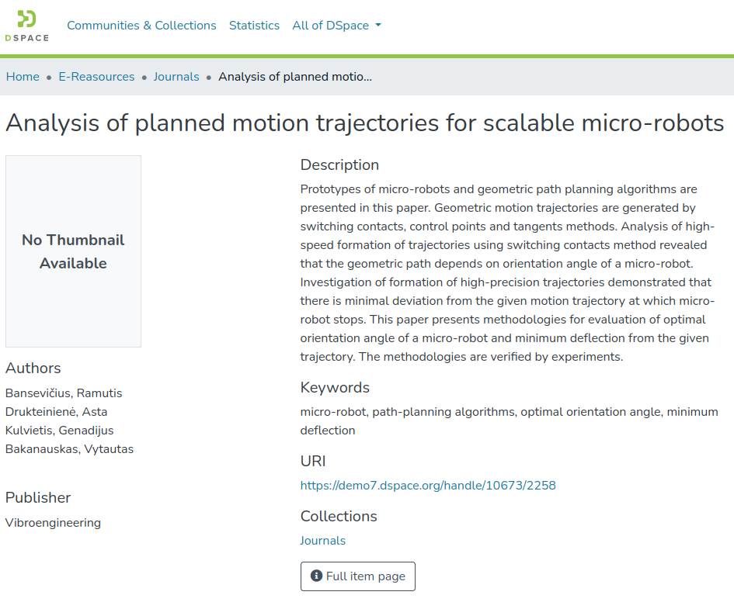
DSpace Item (2/2)
Several Dspace metadata are translated into the VIVO vocabulary:
The corresponding DSpace Url (Clikable)
The abstract
The authors
The keywords translated in vivo:Concept
Michel Héon PhD - heon.michel@uqam.ca - University of Quebec at Montreal

Slide 7
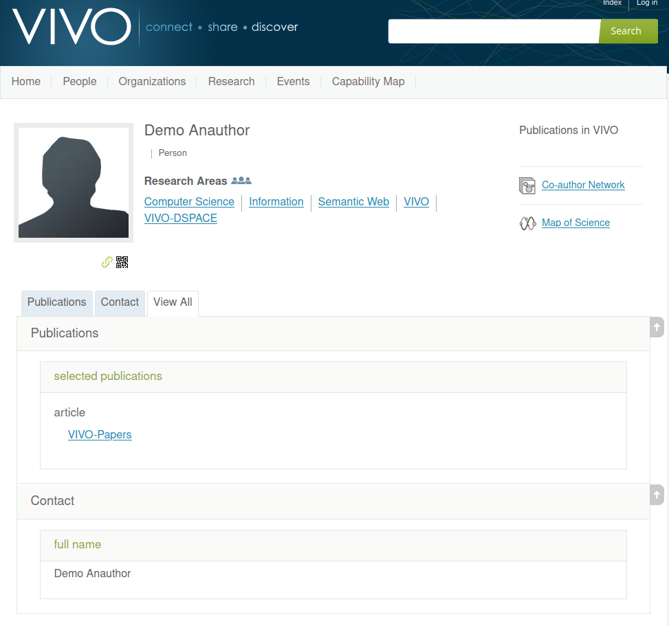
Person
The author's permanent URI is built from a processing on the name String
The topics associated with an Item-Keywords are translated into 'Reseach Area' for the item's author
Michel Héon PhD - heon.michel@uqam.ca - University of Quebec at Montreal

Slide 8
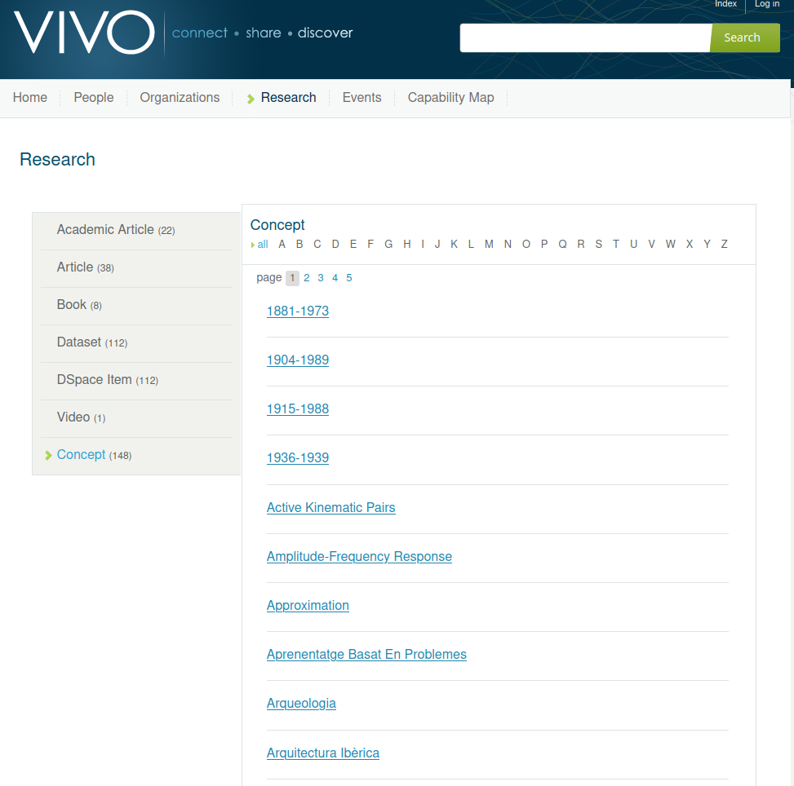
Research Form
The 'DSpace Item' category includes all items from Dspace
The items are categorized into research artifacts
The 'dc:subject' metadata are translated into 'Concept (expertise)'
Michel Héon PhD - heon.michel@uqam.ca - University of Quebec at Montreal

Slide 9
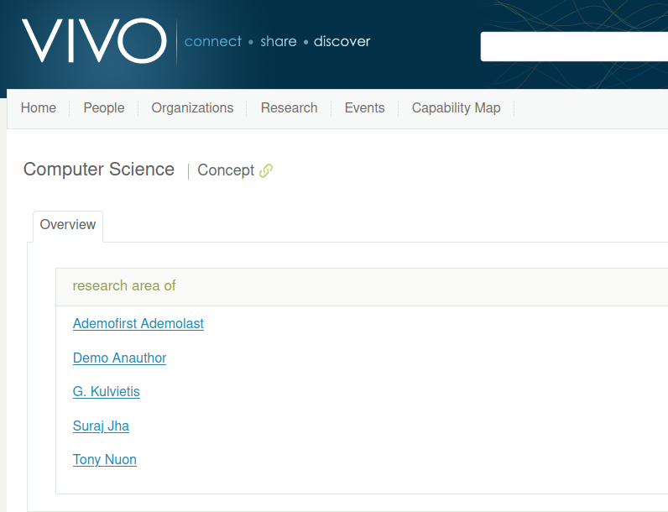
VIVO-Concept (Expertise)
vivo:Concepts (item-keywords) are useful for grouping searchers with a common area of expertise
Michel Héon PhD - heon.michel@uqam.ca - University of Quebec at Montreal

Slide 10
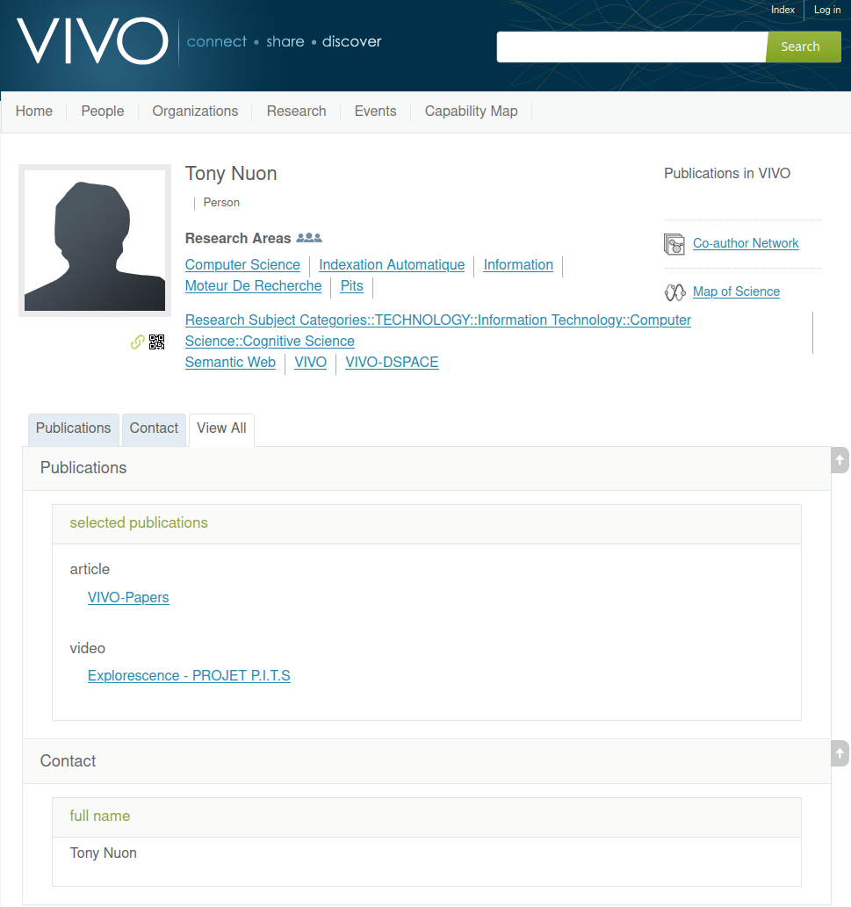
Multiple sources
DSpace Items can come from several DSpace sources
The author's 'Research Area' (expertise) is enriched with publications from various data sources
Michel Héon PhD - heon.michel@uqam.ca - University of Quebec at Montreal

Slide 11
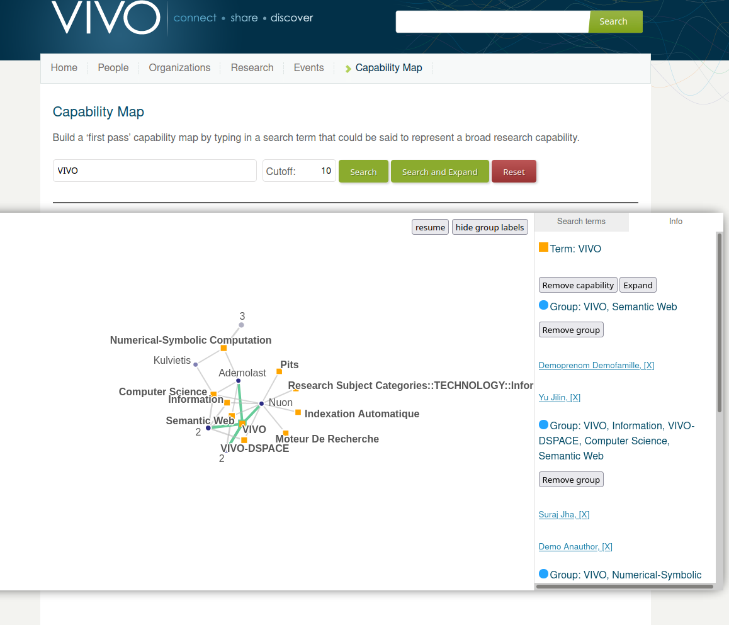
Capability Map Crossing Dspace Instances
The Keyword transformation into a concept allows the expertise and experts mapping by crossing the information coming from the multiple DSpace instances
Michel Héon PhD - heon.michel@uqam.ca - University of Quebec at Montreal

Slide 12
In Short
DSPace-VIVO translation assigns a unique ID to the name and subjects of the Items
VIVO-IRIs are permanent and are generated by a mechanism external to VIVO
Each DSpace-Item is classified according to the VIVO categories
Item-keyword are translated into 'Reaserche Area' for each researcher
VIVO population can easily come from multiple sources
The 'Capability Map' allows a expertise mapping across data sources
Michel Héon PhD - heon.michel@uqam.ca - University of Quebec at Montreal

